Slide 1
Chapter 7 – K-Nearest-Neighbor
Data Mining for Business Analytics
Concepts, Techniques and Applications with JMP Pro
Shmueli, Bruce, Stephens & Patel
© Galit Shmueli, Peter Bruce and Mia Stephens 2016

Slide 2
Characteristics
Data-driven, not model-driven
Makes no assumptions about the data
Conceptually simple/straightforward

Slide 3
Basic Idea
For a given record to be classified, identify nearby records
“Near” means records with similar predictor values X₁, X₂, … X_{p}
Classify the record as whatever the predominant class is among the nearby records (the “neighbors”)

Slide 4
How to measure “nearby”?
The most popular distance measure is Euclidean distance

Slide 5
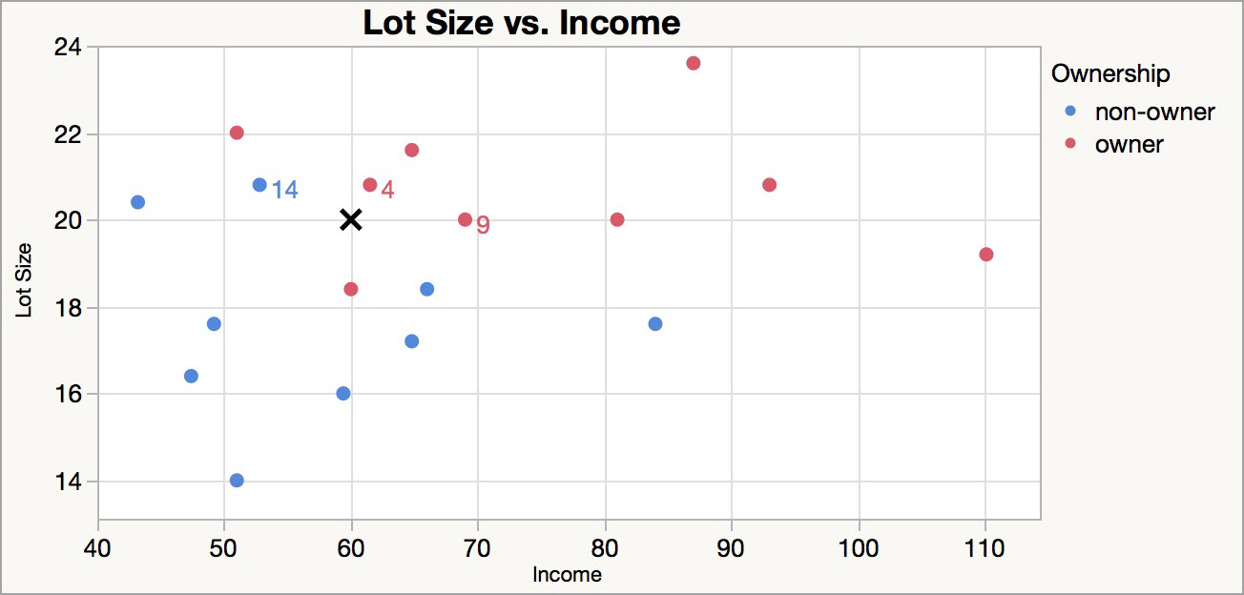
Classifying using nearest neighbors
A new household: Income $60k and Lot Size 20K Ft²
The 3 nearest neighbors are 4 and 9 (owners), and 14 (a non-owner)
Decision: Classify as an owner

Slide 6
Choosing k
K is the number of nearby neighbors to be used to classify the new record
    K=1 means use the single nearest record
    K=5 means use the 5 nearest records
Typically choose that value of k which has lowest error rate in validation data

Slide 7
Low k vs. High k
Low values of k (1, 3, …) capture local structure in data (but also noise)
High values of k provide more smoothing, less noise, but may miss local structure
Note: the extreme case of k = n (i.e., the entire data set) is the same as the “naïve rule” (classify all records according to majority class)

Slide 8
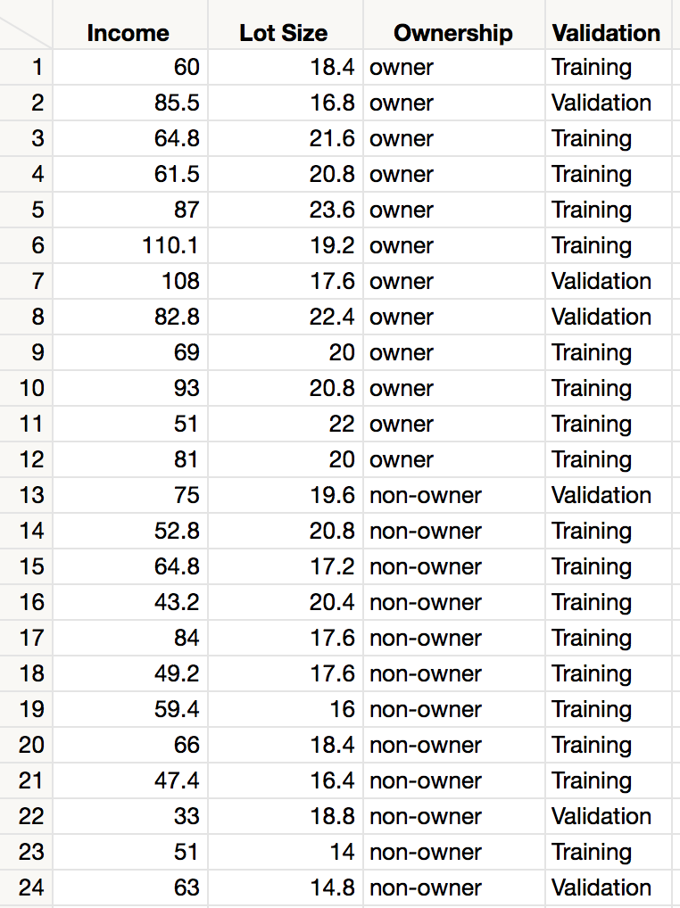
Example: Riding Mowers
Data: 24 households classified as owning or not owning riding mowers
Predictors: Income, Lot Size
Preparation: Data are partitioned into Training (18 households) and Validation (6 households) sets.

Slide 9
Selecting the best k
For each record in validation data (6 records) find neighbors amongst training data (18 records).
The record is scored for k=1, k=2, … k=18.
Best k appears to be k=8.
k = 9, k = 10, k=12 and k=14 also share low error rate, but best to choose lowest k.

Slide 10
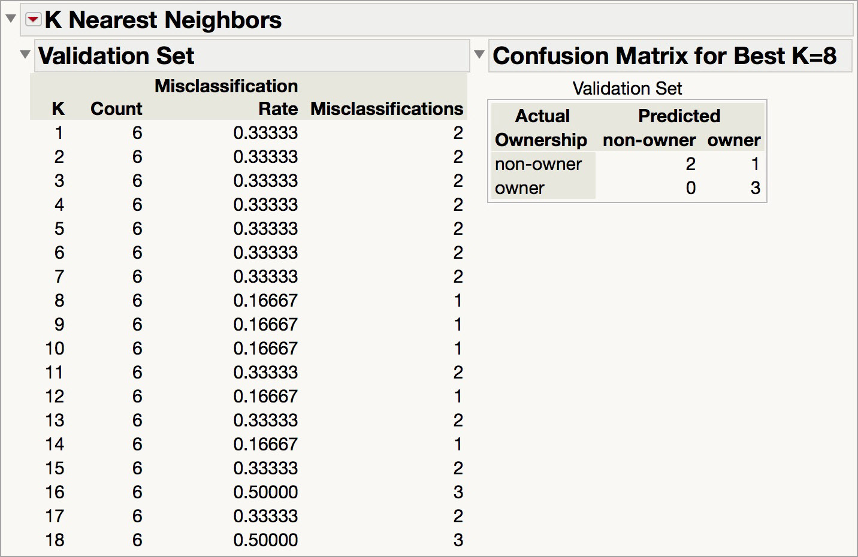
JMP Output and Best k
Notes:
KNN is in the Partition Platform in JMP 12, and is under Predictive Modeling in JMP 13.

Slide 11
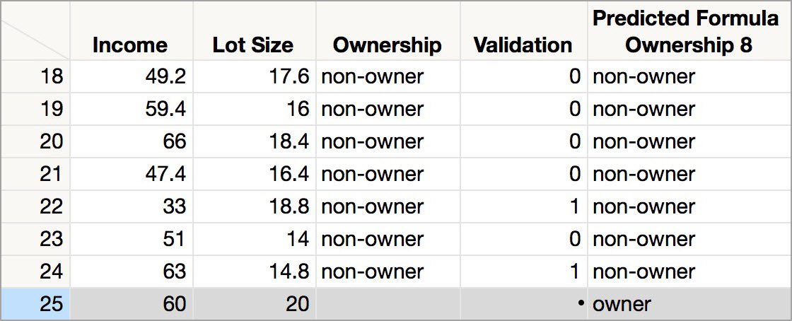
Classifying new records
The new record is classified using the “best k” = 8.
Notes:
Save predicteds to the data table. Then, add a new row with the values for the new record – tab through the Lot Size field to compute the value.

Slide 12
Using K-NN for Prediction
(for Numerical Outcomes)
Instead of “majority vote determines class” use average of response values
May be a weighted average, weight decreasing with distance

Slide 13
Advantages
Simple
No assumptions required about Normal distribution, etc.
Effective at capturing complex interactions among variables without having to define a statistical model

Slide 14
Shortcomings
Required size of training set increases exponentially with # of predictors, p
    This is because expected distance to nearest neighbor increases with p (with large vector of predictors, all records end up “far away” from each other)
In a large training set, it takes a long time to find distances to all the neighbors and then identify the nearest one(s)
These constitute “curse of dimensionality”

Slide 15
Dealing with the Curse
Reduce dimension of predictors (e.g., with PCA)
Computational shortcuts that settle for “almost nearest neighbors”
In JMP, predictions aren’t made until the prediction formula is saved to the data table (a computational time-saver)

Slide 16
Summary
Find distance between record-to-be-classified and all other records
Select k-nearest records
    Classify it according to majority vote of nearest neighbors
    Or, for prediction, take the as average of the nearest neighbors
“Curse of dimensionality” – need to limit # of predictors

